Slide 1

Software Size Estimation Techniques
3 day workshop
Mercedes Benz
Trainer :Hari Prasad Thapliyal
MBA, MCA, PGDOM, PGDFM, CIC, MCITP, MCTS, CSM
Mentor, Trainer & Coach - PMP, PMI-ACP, PRINCE2, Agile
[PMI-ACP : #318050]
[PMP : #1563385]
Colossal Technologies
#106, 18th Main, HAL 2nd Stage, Indiranagar
Bangalore, Karnataka 560008
http://www.colossaltechnologies.com
Content related queries please write to hari.prasad@vedavit-ps.com
'PMI-ACP', 'PMI', and 'ACP' are a registered marks of the Project Management Institute, Inc.
This presentation copy is authorized only for Mercedes Benz, Indiranagar, Bangalore workshop conducted on 05-06-07-Apr-16.
'PMI-ACP', 'PMI', and 'ACP' are a registered marks of the Project Management Institute, Inc.

Slide 2
Case Studies

Slide 3
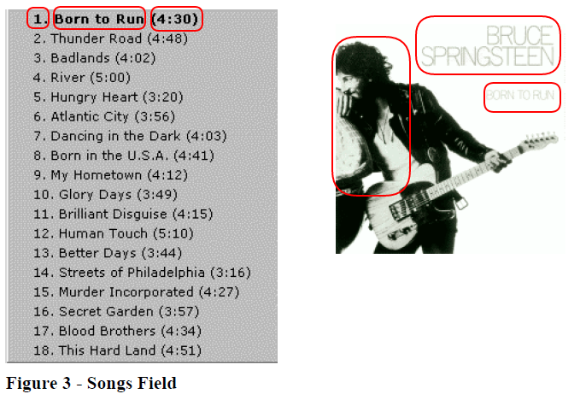
How Many DET?
Artist, Album Name, Publication Date, and Songs (number, title, duration)

Slide 4
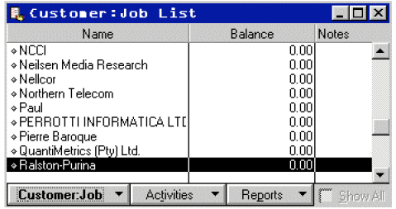
If customer click on any row then an Edit Screen is shown. What is the click functionality? How many FP for this functionality?

Slide 5
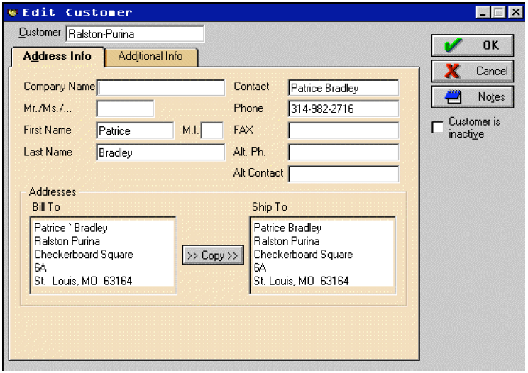
How many FP for “Edit Customer” functionality?

Slide 6
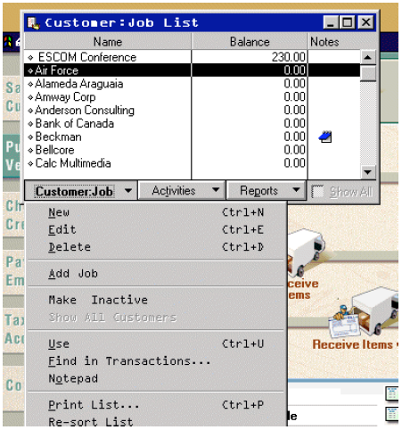
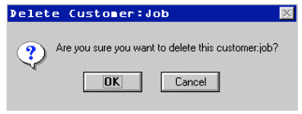
What is “Delete Job” functionality and how many FP?

Slide 7
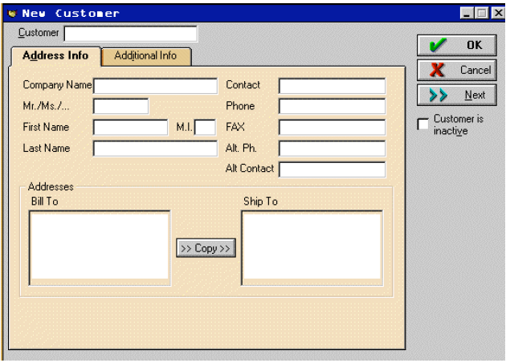
How many FP for “New Customer” functionality?

Slide 8
How many EQ’s does the Customer Button
How many EQ’s does the Customer: Job List and
How many EQ’s does the Edit Customer represent?

Slide 9
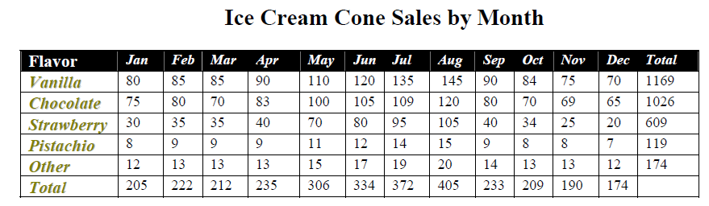
How many DET in this table
Ans: Flavor, Month, Total by Flavor, Total by Month or 4 DET’s
The recursive information is flavor, months and the totals.

Slide 10
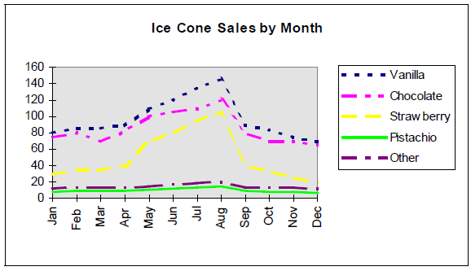
How many data elements are there in the following line chart
Ans: 2 data elements. Flavor and Month

Slide 11
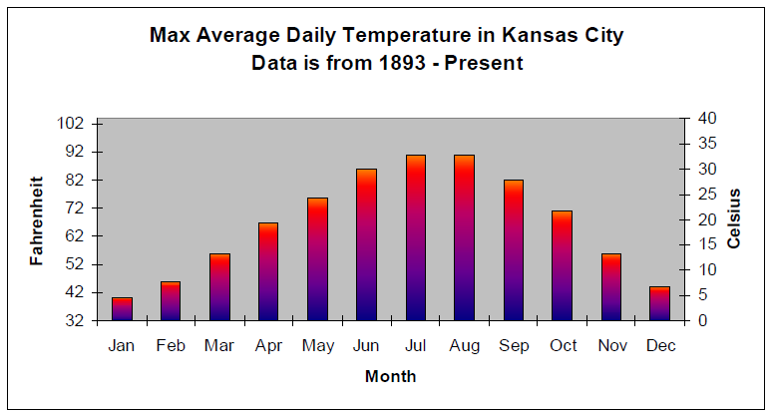
How many DET?
Ans: 3

Slide 12
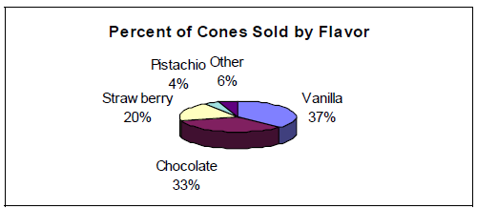
Ans: 2

Slide 13
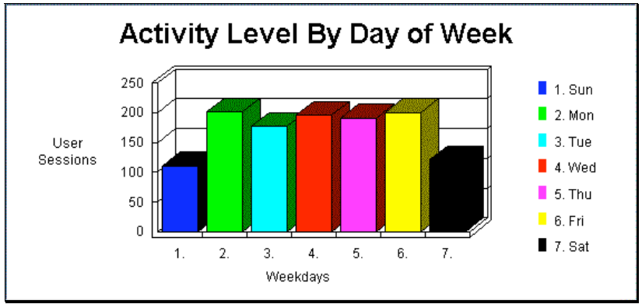
Ans: only 2 data elements - user session and day of week

Slide 14
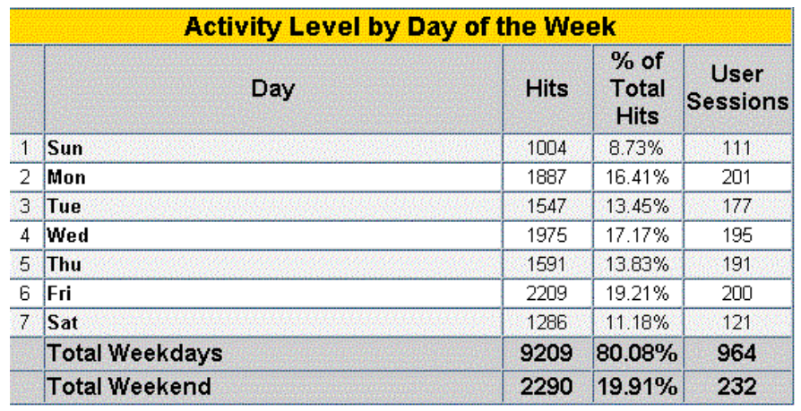
Days, Hits, % of Total Hits and User Sessions all have recursive data.
Ans: 10

Slide 16
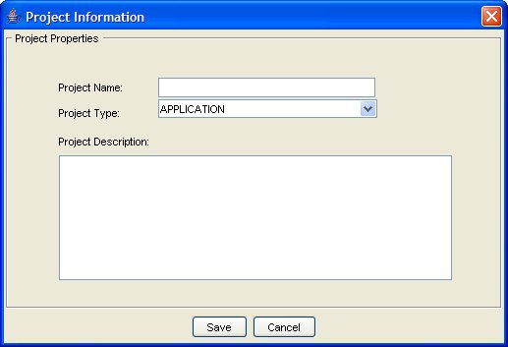

Slide 17
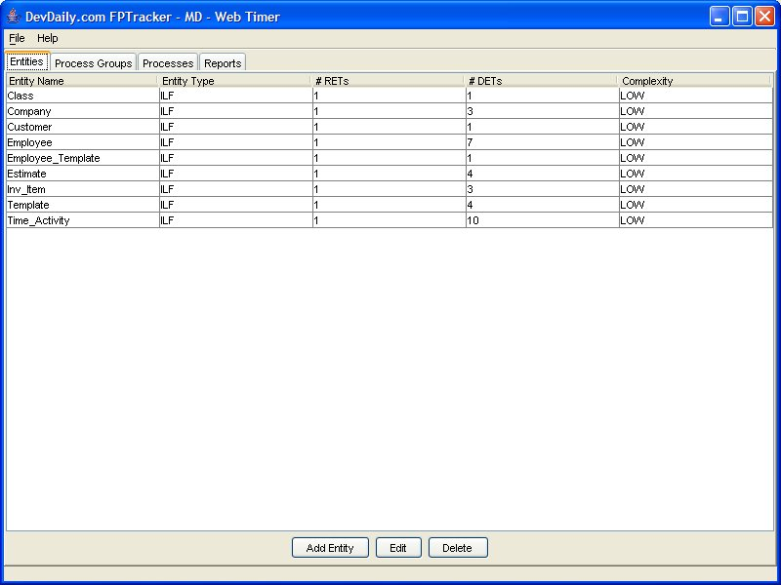

Slide 18
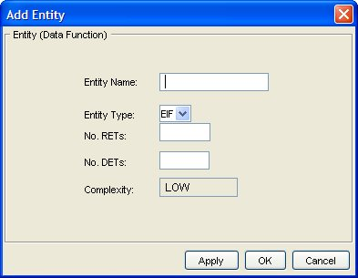

Slide 19
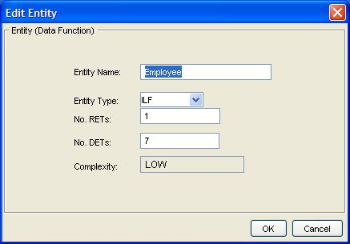

Slide 20
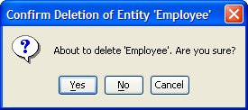

Slide 21
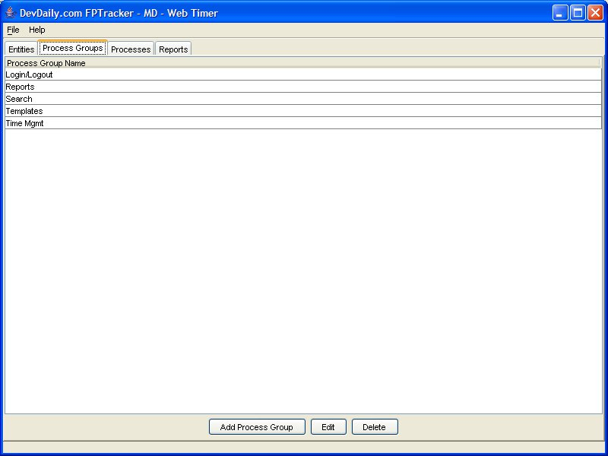

Slide 22
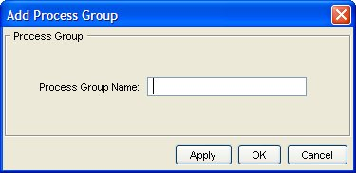

Slide 23
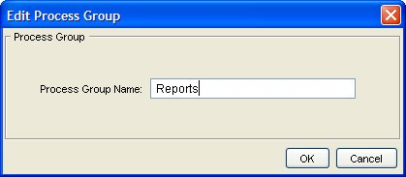

Slide 24
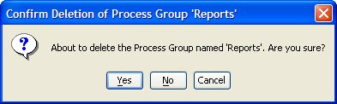

Slide 25
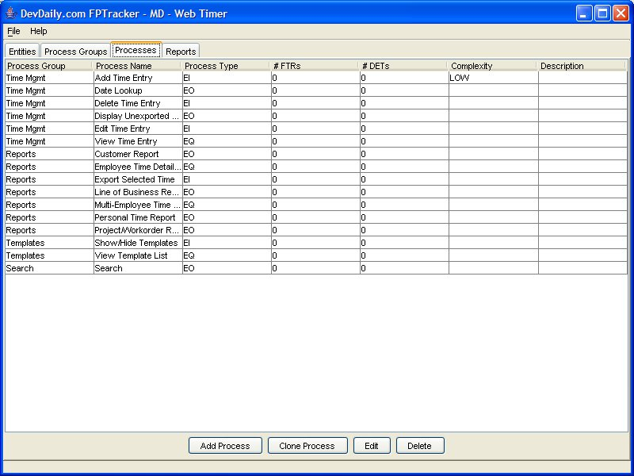

Slide 26
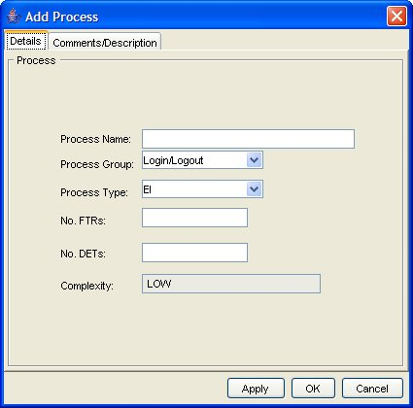

Slide 27
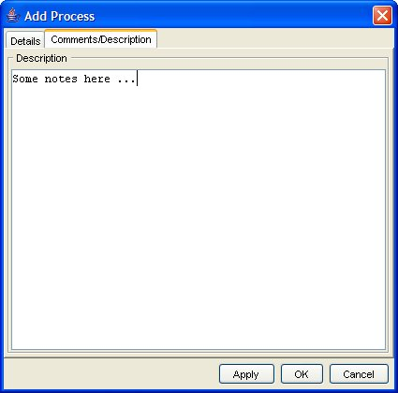

Slide 28
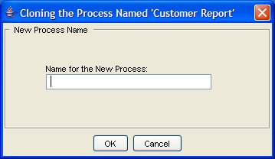

Slide 29
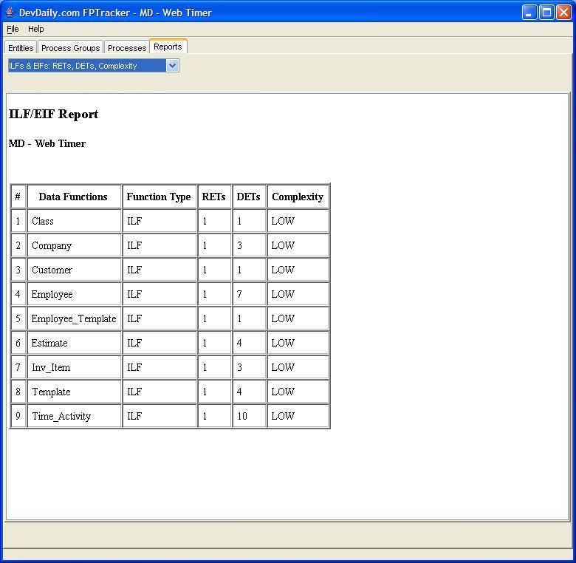

Slide 30
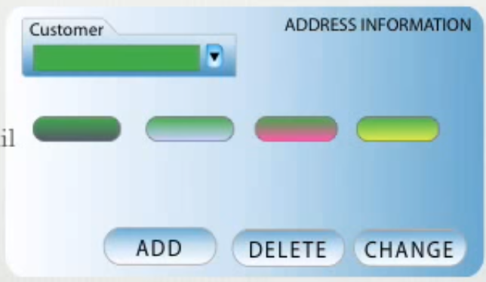

Slide 31
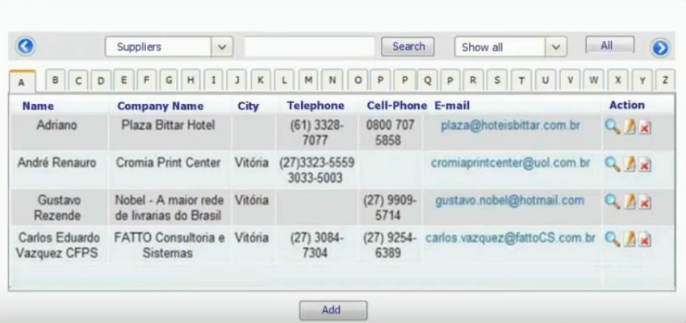

Slide 32
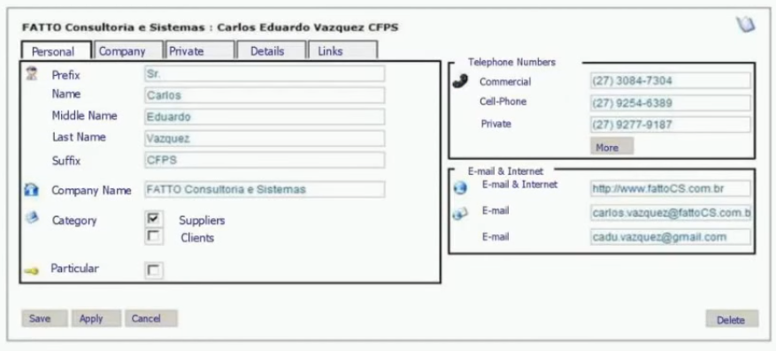

Slide 33
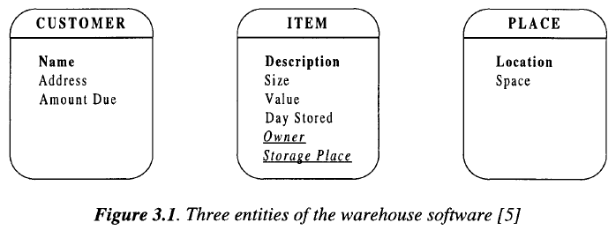

Slide 34
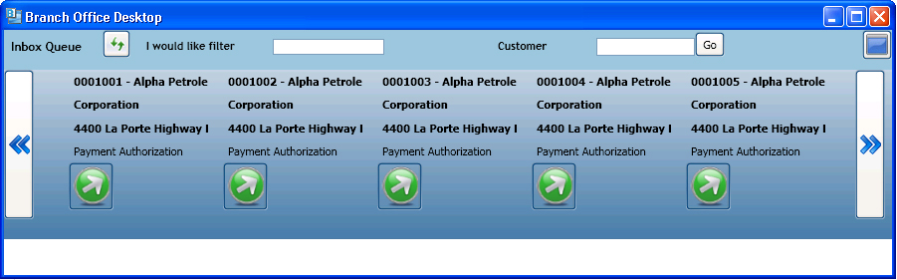

Slide 35
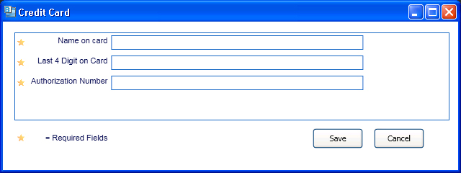

Slide 36
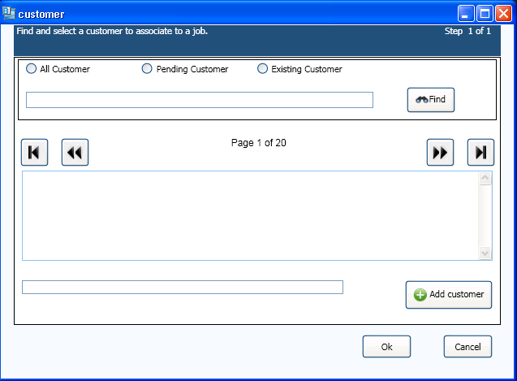

Slide 37
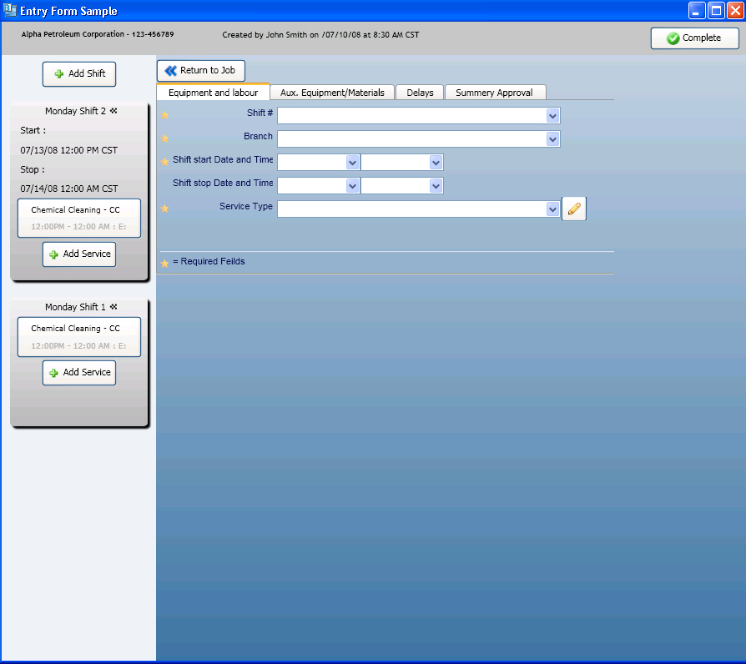

Slide 38
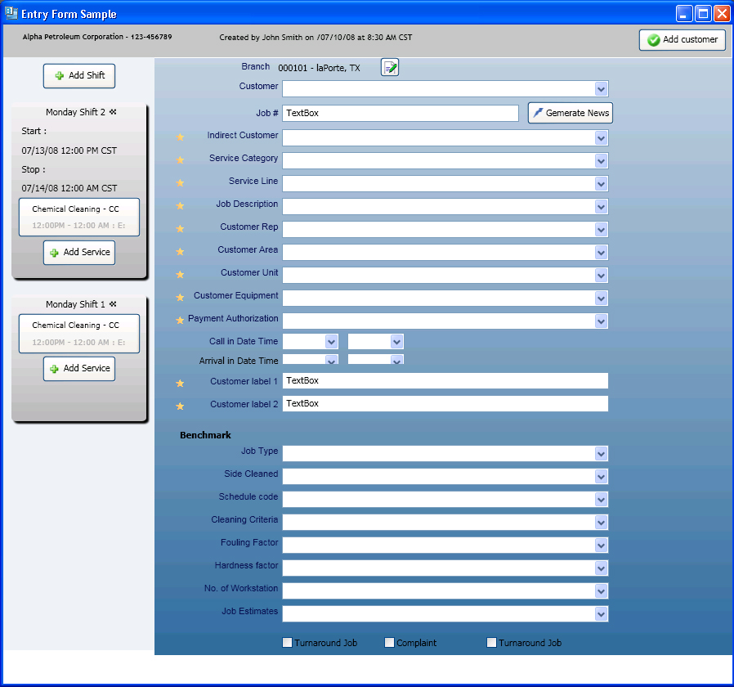

Slide 39
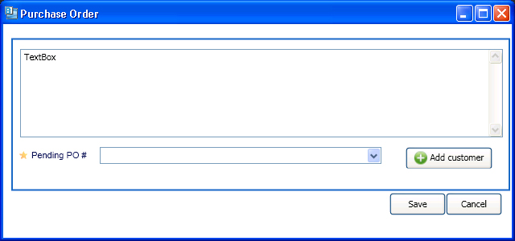

Slide 40

Hari P Thapliyal,
PMP, PMI-ACP, MCITP, PRINCE2 Practitioner, CSM, MBA, MCA, CIC, PGDFM
PMO Architect & Project Management Evangelist
Profile: http://in.linkedin.com/in/harithapliyal
For content related queries please contact me via
hari.Prasad@vedavit-ps.com
This document is proprietary and confidential. It remains the property of Vedavit Project Solutions at all times. No part of this document may be used, reproduced, or transmitted in any form or by any means electronic, including photocopying and recording, for any purpose without express consent of Vedavit Project Solutions.

